Slide 1
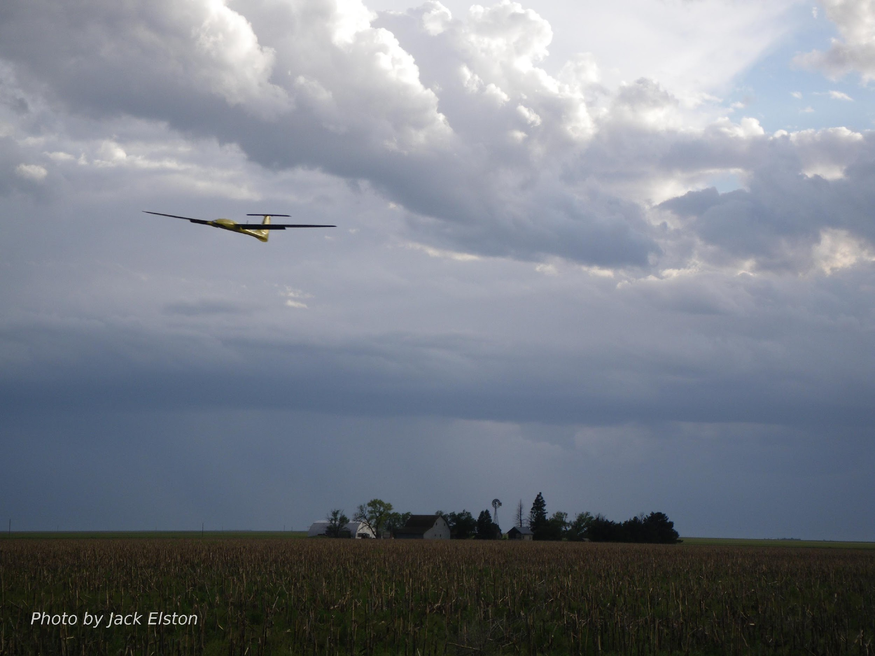
Chapter 9
Nonlinear Design Models

Slide 2
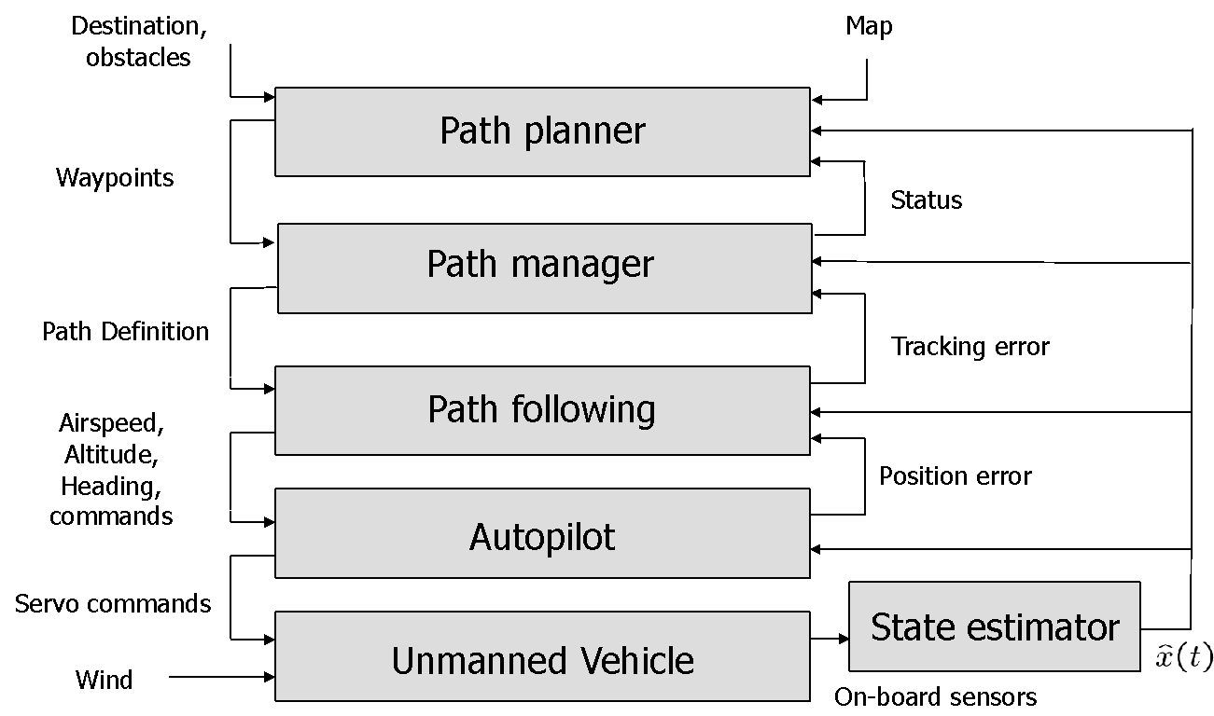
Architecture

Slide 3
Simplifying Dynamic Models
When designing higher level autopilot functions, we need models that are easier to analyze and simulate
Models must capture the essential behavior of system
We will derive reduced-order, reduced-complexity models suitable for design of higher-level guidance strategies
Two types of guidance models:
Kinematic – utilize kinematic relationships, do not consider aerodynamics, forces directly
Dynamic – apply force balance relations to point-mass models

Slide 4
Autopilot Models (transfer function)
Notes:
\begin{minipage}{3.0in}
Airspeed hold and roll hold loops can be modeled as:
\[
V_a(s) = \frac{{\color{magenta}b_{V_a}}}{s+{\color{magenta}b_{V_a}}}{\color{blue}V_a^c}(s) \qquad\qquad
\phi(s) = \frac{{\color{magenta}b_{\phi}}}{s+{\color{magenta}b_{\phi}}}{\color{blue}\phi^c}(s)
\]
Altitude and course hold loops can be modeled as:
\[
h(s) = \frac{{\color{magenta}b_{\dot{h}}}s+{\color{magenta}b_h}}{s^2 +
{\color{magenta}b_{\dot{h}}}s + {\color{magenta}b_h}}{\color{blue}h^c}(s) \qquad\qquad
\chi(s) = \frac{{\color{magenta}b_{\dot{\chi}}}s + {\color{magenta}b_{\chi}}}
{s^2 + {\color{magenta}b_{\dot{\chi}}}s + {\color{magenta}b_{\chi}}}{\color{blue}\chi^c}(s)
\]
Alternatively, the heading hold loop can be modeled as:
\[
\psi(s) = \frac{{\color{magenta}b_{\dot{\psi}}}s + {\color{magenta}b_{\psi}}}
{s^2 + {\color{magenta}b_{\dot{\psi}}}s + {\color{magenta}b_{\psi}}}{\color{blue}\psi^c}(s)
\]
Flight-path angle and load factor loops can be modeled as:
\[
\gamma(s) = \frac{{\color{magenta}b_{\gamma}}}{s+{\color{magenta}b_{\gamma}}}{\color{blue}\gamma^c}(s) \qquad\qquad
n_{\mathit{lf}}(s) = \frac{{\color{magenta}b_n}}{s+{\color{magenta}b_n}}{\color{blue}n_{\mathit{lf}}^c}(s)
\]
\end{minipage}

Slide 5
Autopilot Models
Notes:
\begin{minipage}{3.0in}
Airspeed hold and roll hold loops can be modeled as:
\begin{align*}
\dot{V}_a &= {\color{magenta}b_{V_a}}({\color{blue}V_a^c} - V_a) \\
\dot{\phi} &= {\color{magenta}b_{\phi}}({\color{blue}\phi^c} - \phi)
\end{align*}
Altitude and course hold loops can be modeled as:
\begin{align*}
\ddot{h} &= {\color{magenta}b_{\dot{h}}}(\dot{h}^c - \dot{h}) + {\color{magenta}b_h}({\color{blue}h^c}-h) \\
\ddot{\chi} &= {\color{magenta}b_{\dot{\chi}}}(\dot{\chi}^c-\dot{\chi}) + {\color{magenta}b_{\chi}}({\color{blue}\chi^c} - \chi)
\end{align*}
Alternatively, the heading hold loop can be modeled as:
\[
\ddot{\psi} = {\color{magenta}b_{\dot{\psi}}}(\dot{\psi}^c-\dot{\psi}) + {\color{magenta}b_{\psi}}({\color{blue}\psi^c} - \psi)
\]
Flight-path angle and load factor loops can be modeled as:
\begin{align*}
\dot{\gamma} &= {\color{magenta}b_{\gamma}}({\color{blue}\gamma^c} - \gamma) \\
\dot{n}_{\mathit{lf}} &= {\color{magenta}b_n} ({\color{blue}n_{\mathit{lf}}^c} - n_{\mathit{lf}})
\end{align*}
\end{minipage}

Slide 6
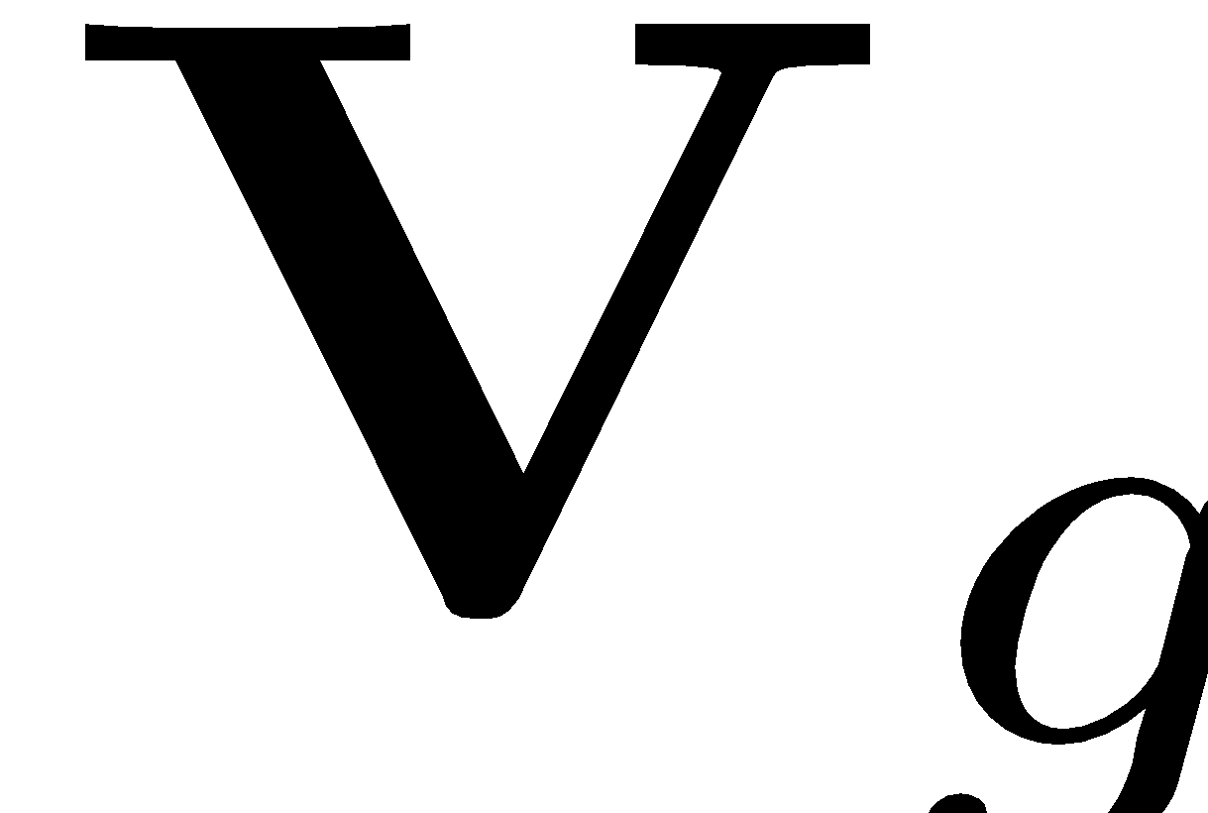
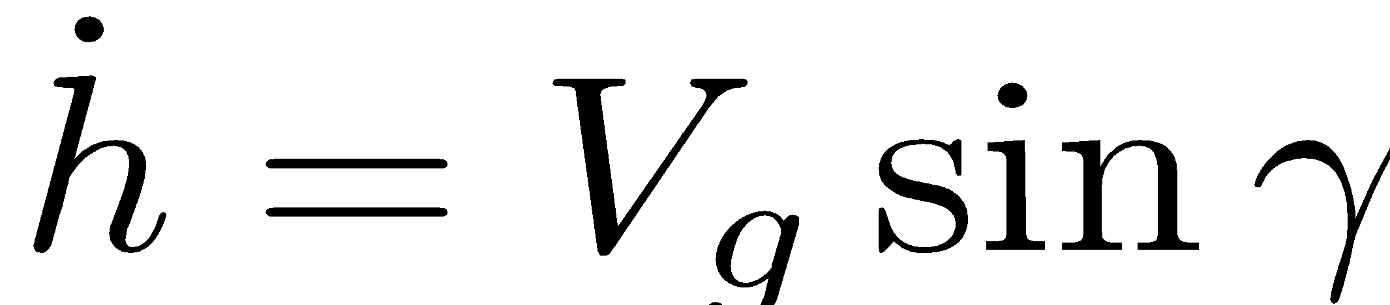
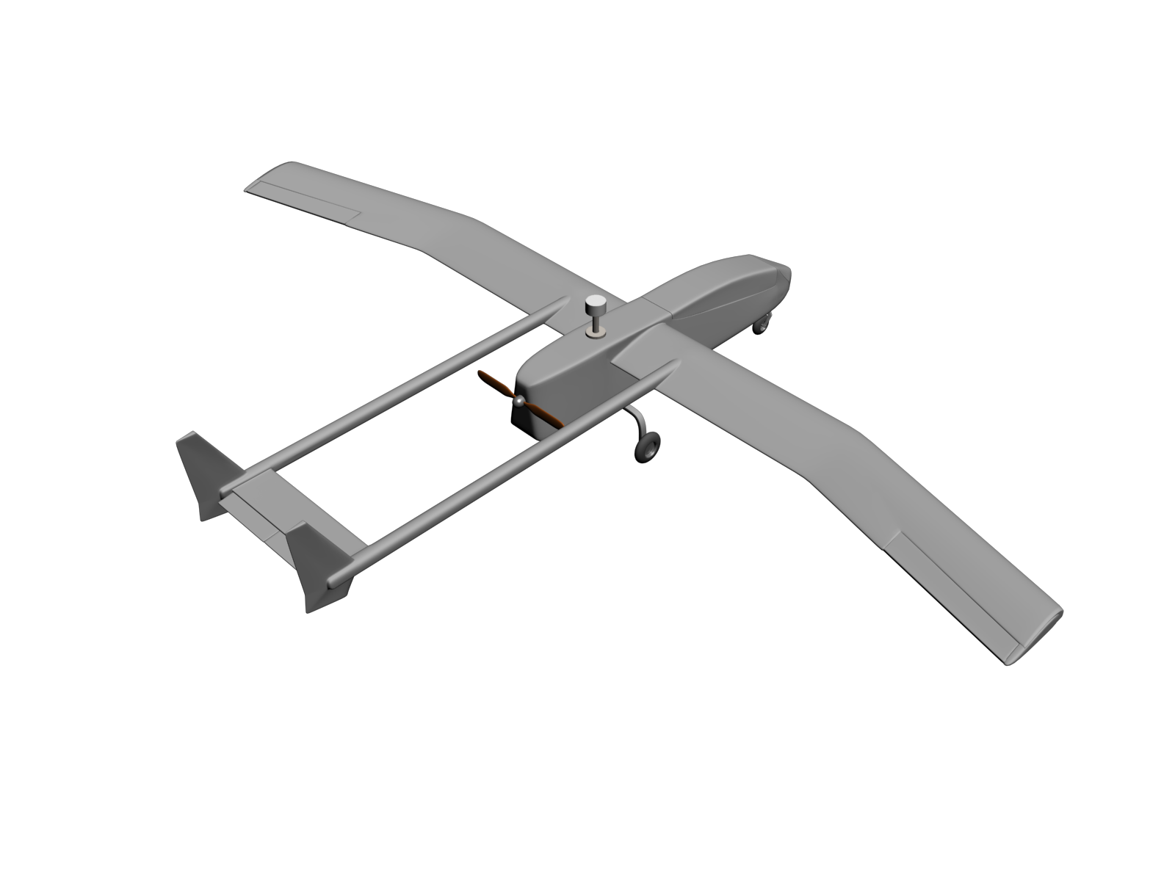
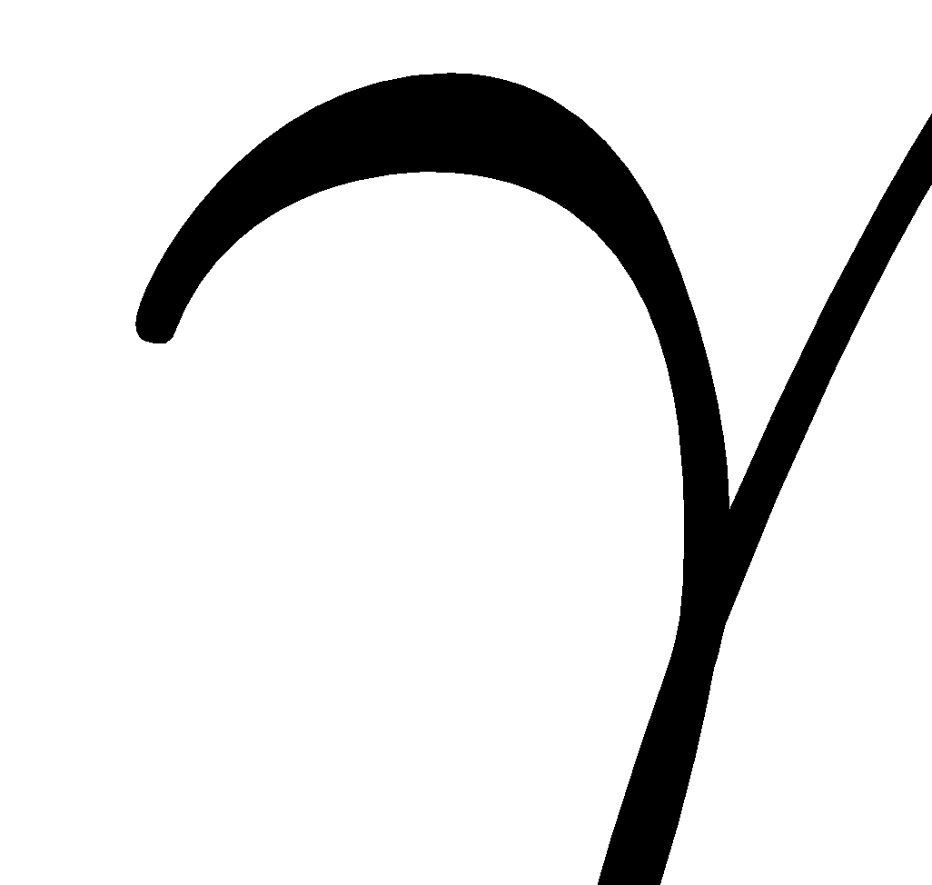
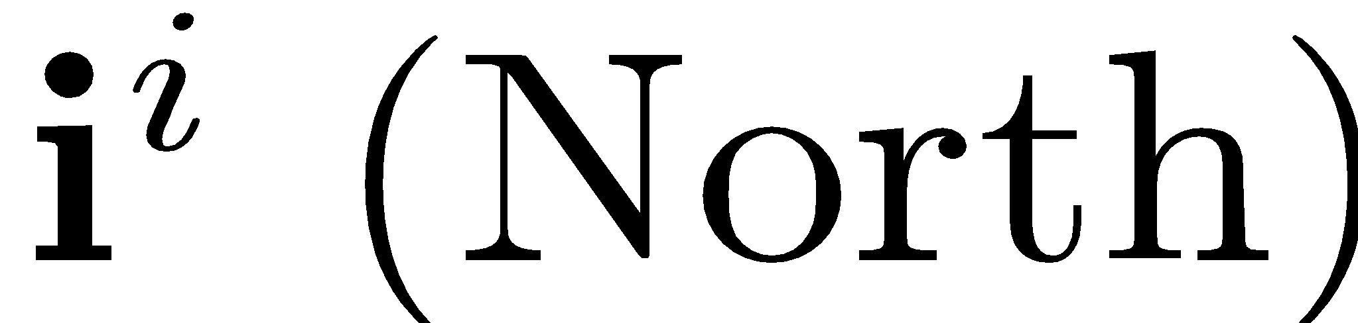
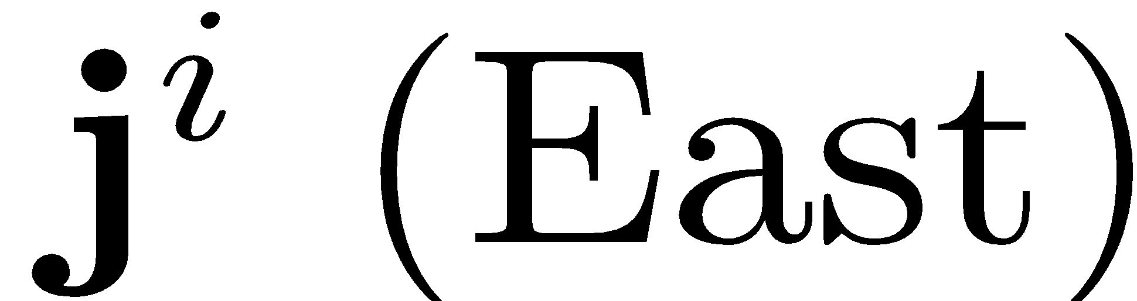
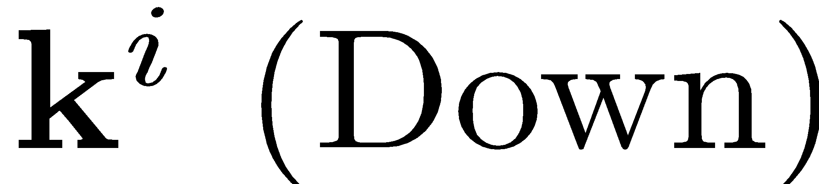
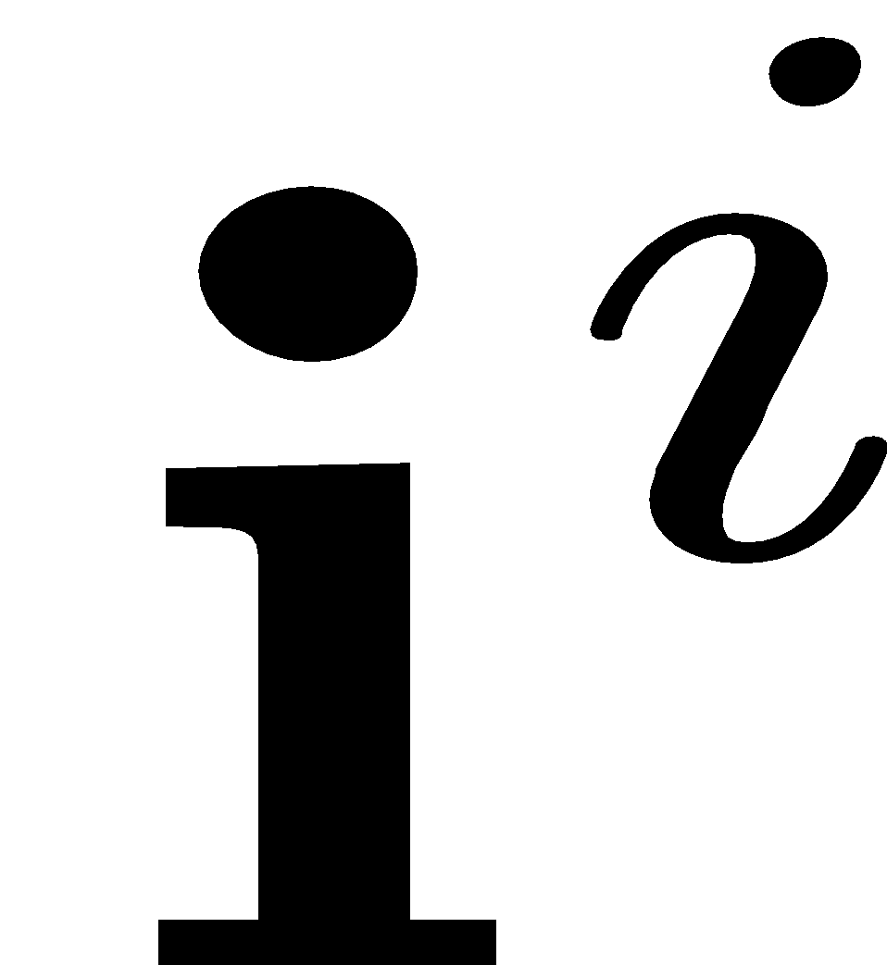
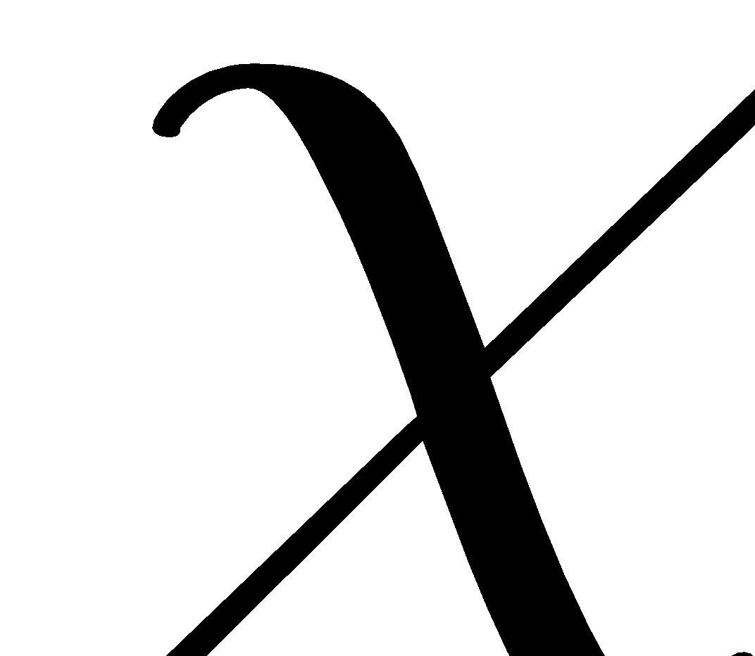
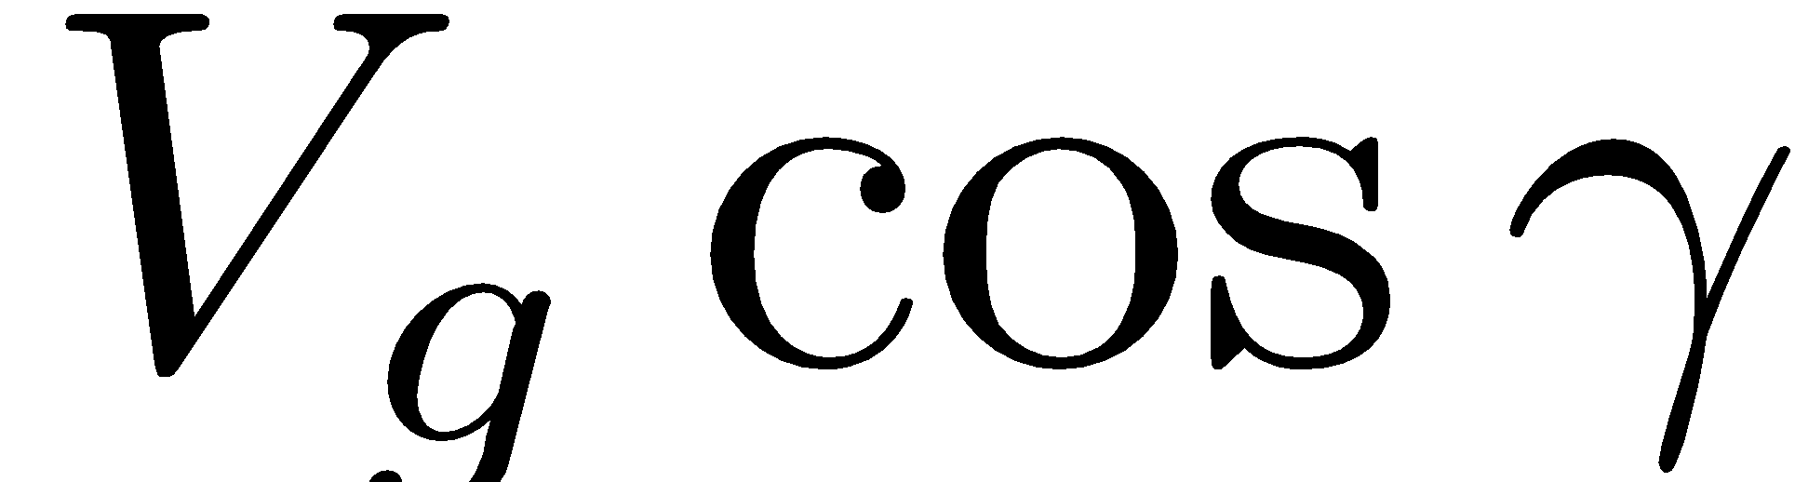
Kinematic Model of Controlled Flight
horizontal component
of groundspeed vector
Flight path projected onto ground
Notes:
\begin{minipage}{3.0in}
\noindent The velocity vector can be written as
\[
\mathbf{V}_g^i = V_g \begin{pmatrix} \cos\chi\cos\gamma \\ \sin\chi\cos\gamma \\ -\sin\gamma \\\end{pmatrix}
\]
which gives:
\[
\begin{pmatrix} \dot{p}_n \\ \dot{p}_e \\ \dot{h} \end{pmatrix}
= V_g \begin{pmatrix}
\cos\chi\cos\gamma \\
\sin\chi\cos\gamma \\
\sin\gamma
\end{pmatrix}
\]
Alternatively, using the Wind Triangle:
\[
\begin{pmatrix} \dot{p}_n \\ \dot{p}_e \\ \dot{h} \end{pmatrix}
= V_a \begin{pmatrix}
\cos\psi\cos\gamma_a \\
\sin\psi\cos\gamma_a \\
\sin\gamma_a
\end{pmatrix} + \begin{pmatrix} w_n \\ w_e \\ -w_d \end{pmatrix}
\]
\end{minipage}

Slide 7
Kinematic Model of Controlled Flight
horizontal component
of groundspeed vector
Flight path projected onto ground
Notes:
\begin{minipage}{3.0in}
\noindent Beginning with
\[
\begin{pmatrix} \dot{p}_n \\ \dot{p}_e \\ \dot{h} \end{pmatrix}
= V_a \begin{pmatrix}
\cos\psi\cos\gamma_a \\
\sin\psi\cos\gamma_a \\
\sin\gamma_a
\end{pmatrix} + \begin{pmatrix} w_n \\ w_e \\ -w_d \end{pmatrix}
\]
\noindent
and assuming level flight, i.e., $\gamma_a=0$, \\
and no down component of wind, \\
i.e., $w_d=0$:
\[
\begin{pmatrix} \dot{p}_n \\ \dot{p}_e \\ \dot{h} \end{pmatrix}
= V_a \begin{pmatrix}
\cos\psi \\
\sin\psi \\
0
\end{pmatrix} + \begin{pmatrix} w_n \\ w_e \\ 0 \end{pmatrix}
\]
This equation is typically called the Dubin’s car model.

Slide 8
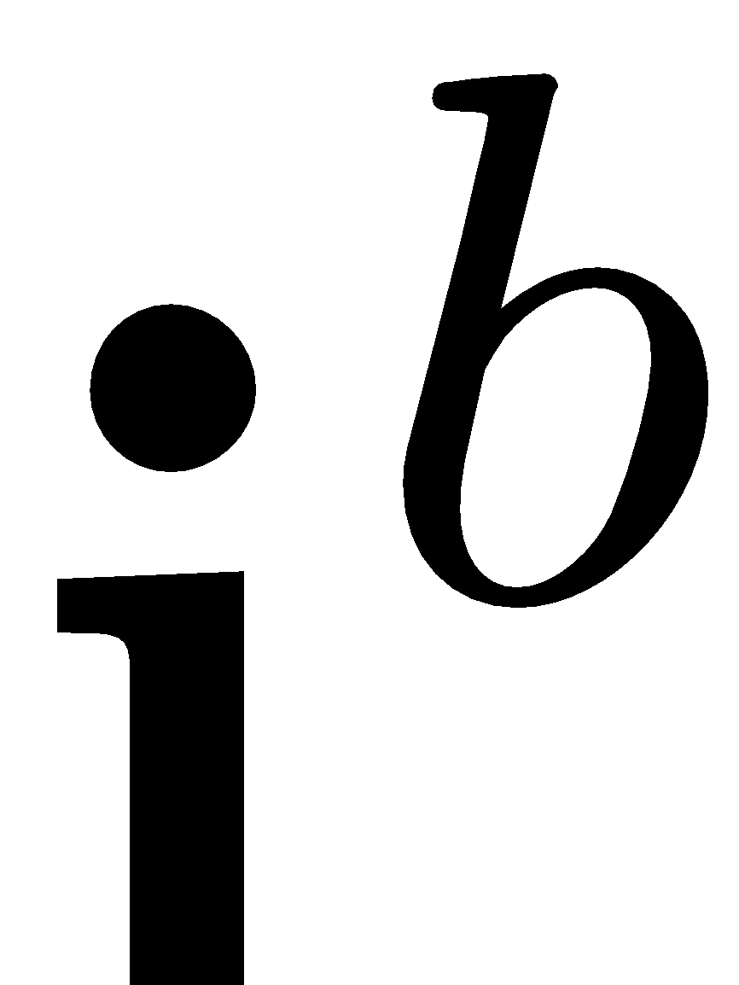
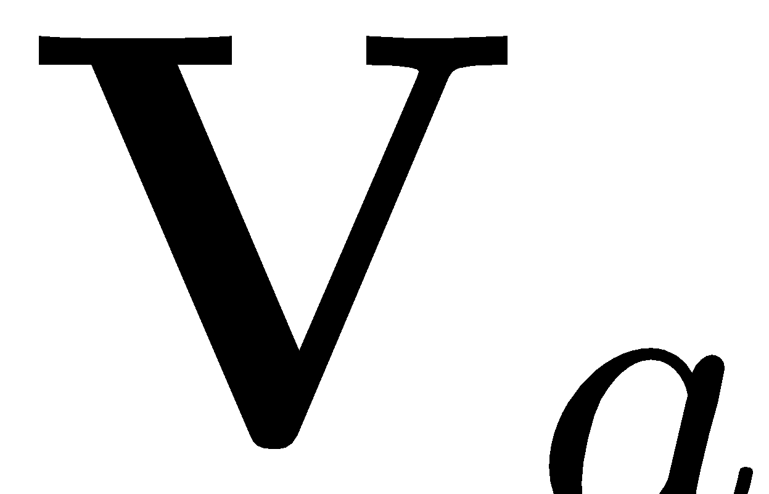
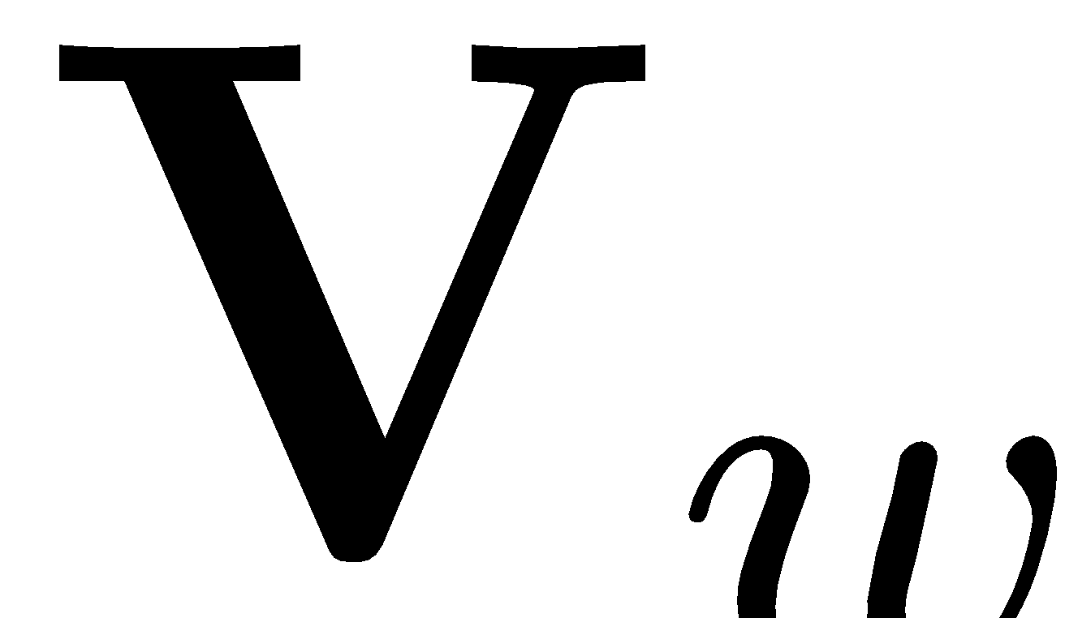

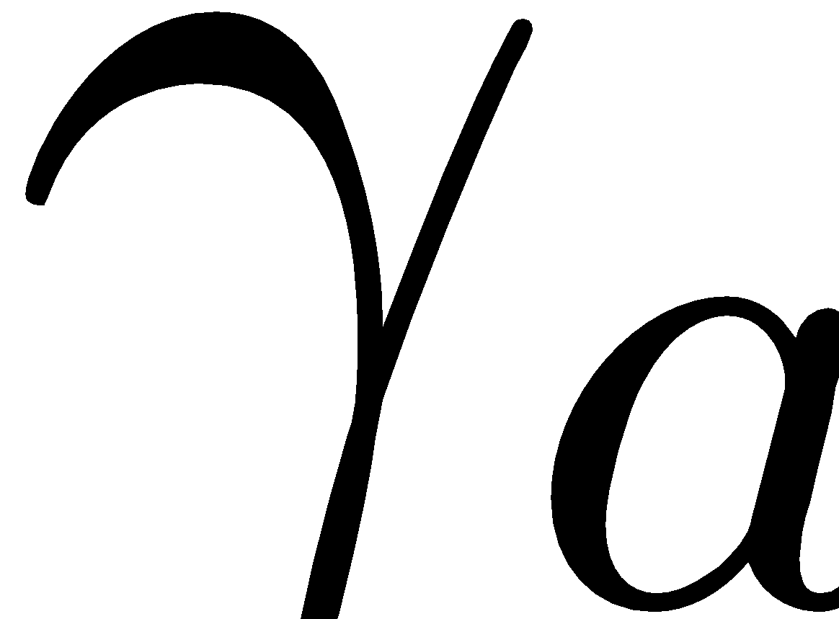

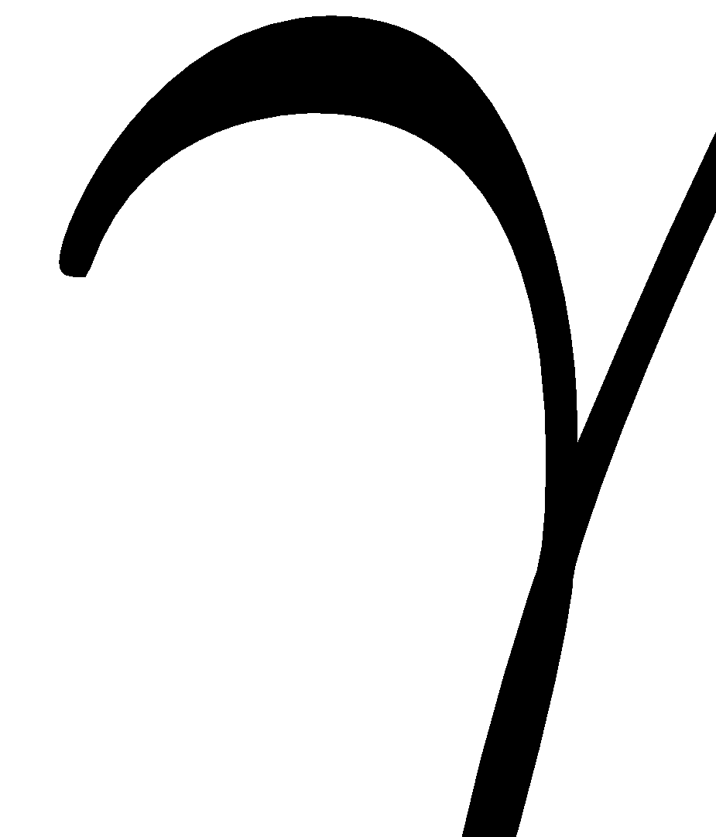
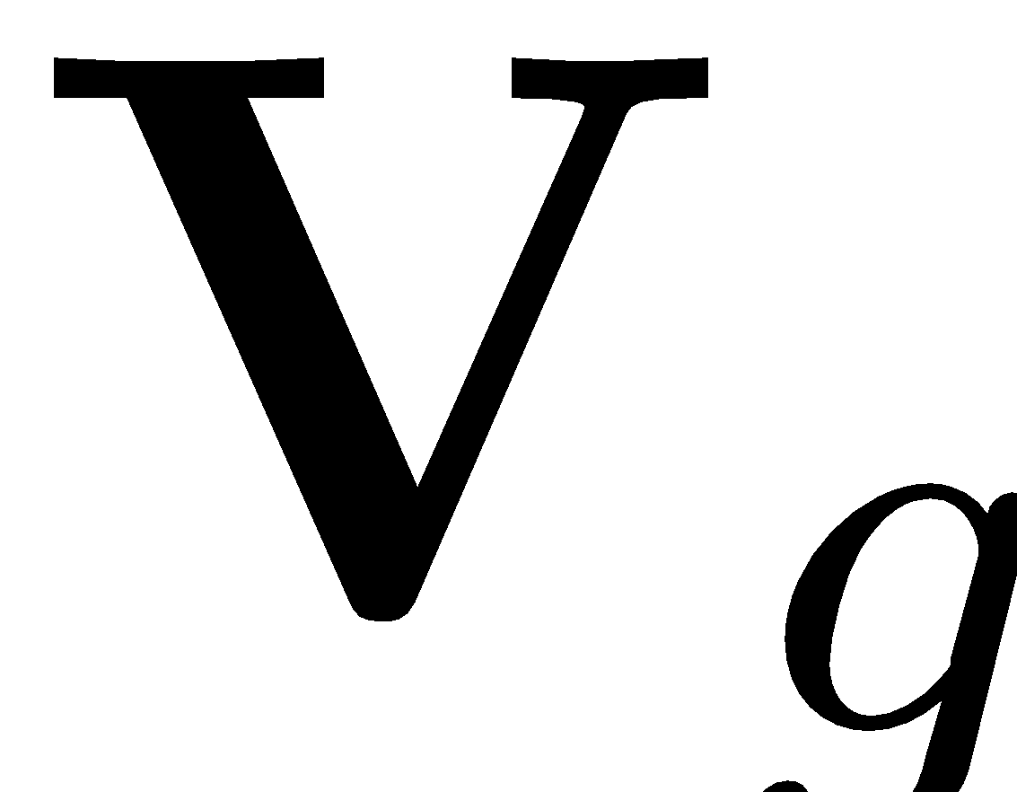
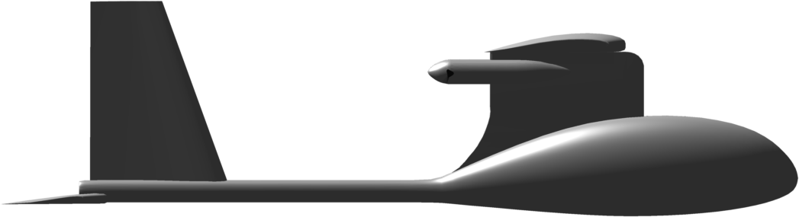
Coordinated Turn
Differentiate both sides of
vector wind-triangle equation (2.9). Solve resulting messy matrix
equation.
Notes:
\begin{minipage}{3.0in}
From Chapter 2 we have
\[
\dot\chi = \frac{g}{V_g}\tan\phi\cos(\chi-\psi)
\]
For constant-altitude flight with no down component of wind:
\begin{align*}
\dot{V}_g &= \frac{\dot{V}_a}{\cos(\chi-\psi)} + V_g\dot{\chi}\tan(\chi-\psi) \label{eq:nonlinear-Vg-dot}\\
\dot{\psi} &= \frac{\dot{V}_a}{V_a}\tan(\chi-\psi) + \frac{V_g\dot{\chi}}{V_a\cos(\chi-\psi)}
\end{align*}
If airspeed is constant, then we get the standard coordinated turn condition
\[
\dot\psi = \frac{g}{V_a}\tan\phi
\]
which is true even if when $w_n, w_e \neq 0$.
\end{minipage}

Slide 9
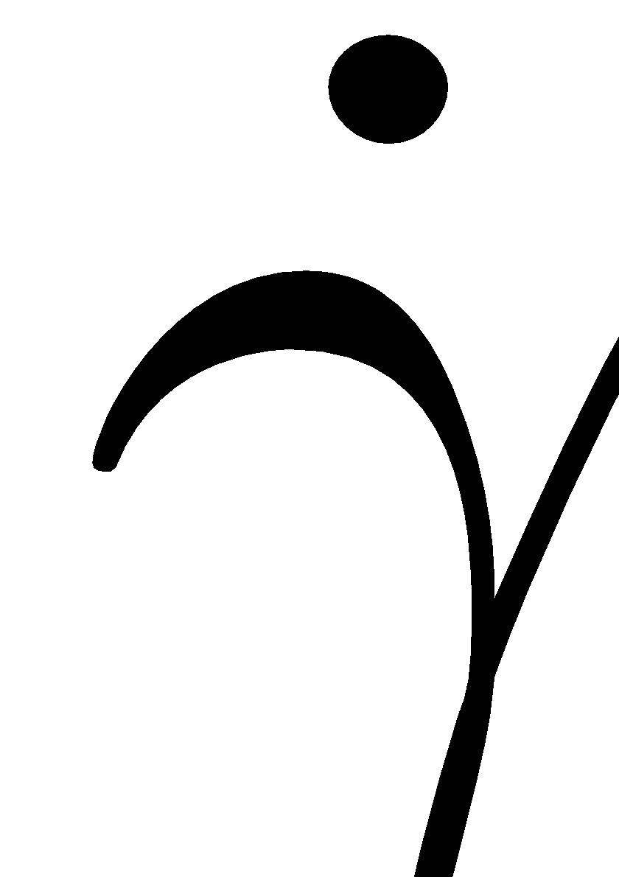
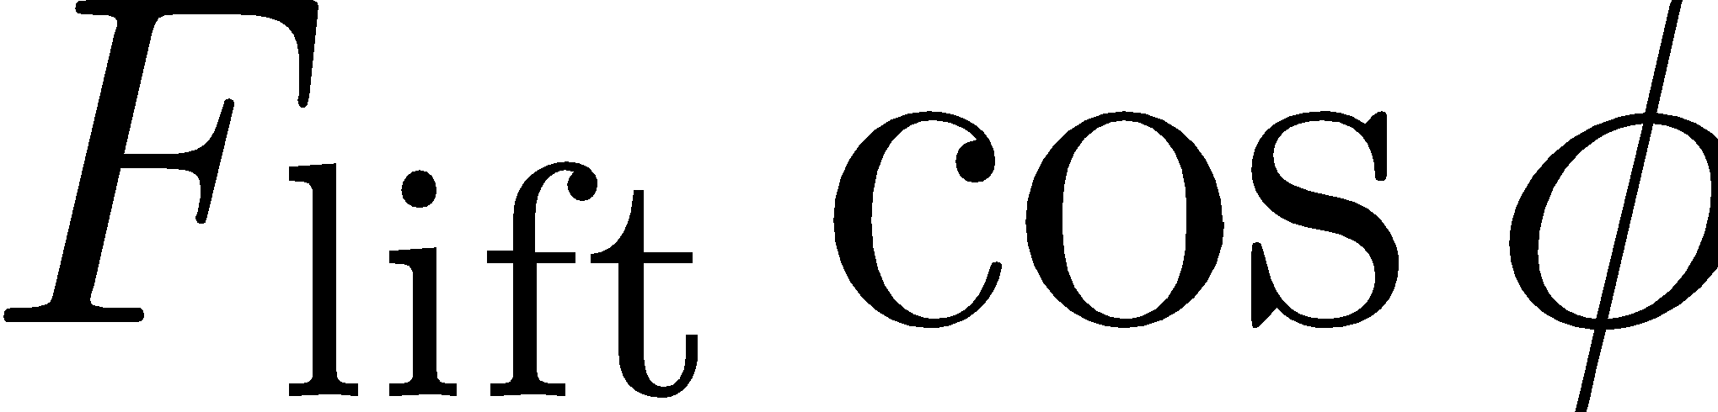
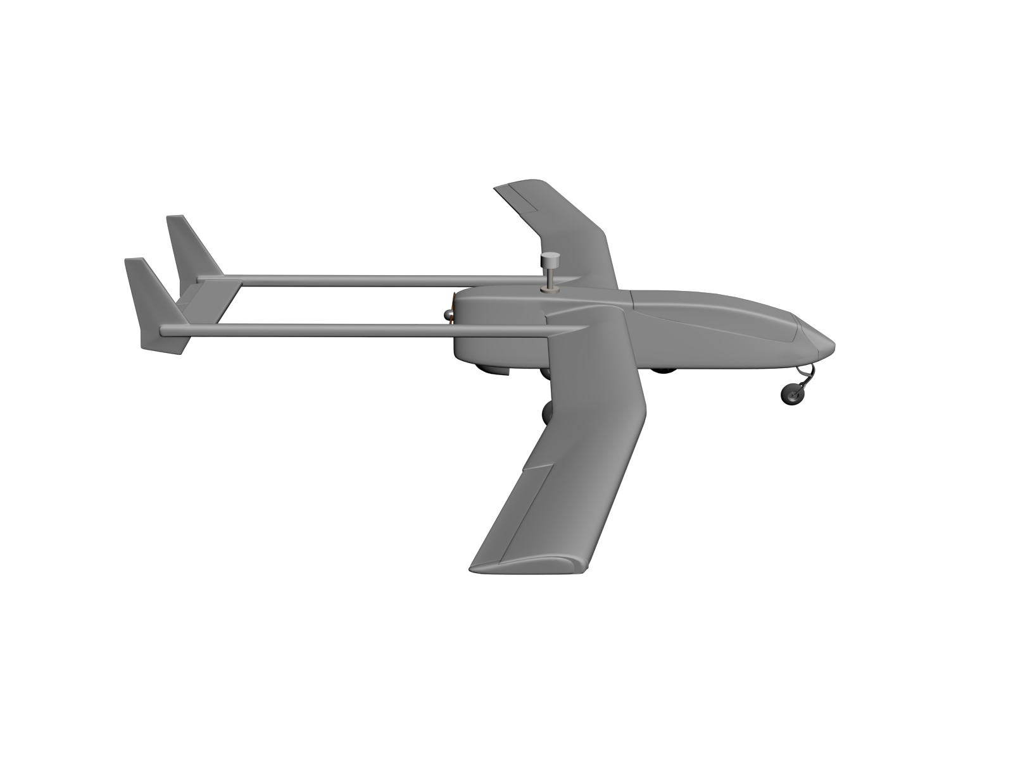
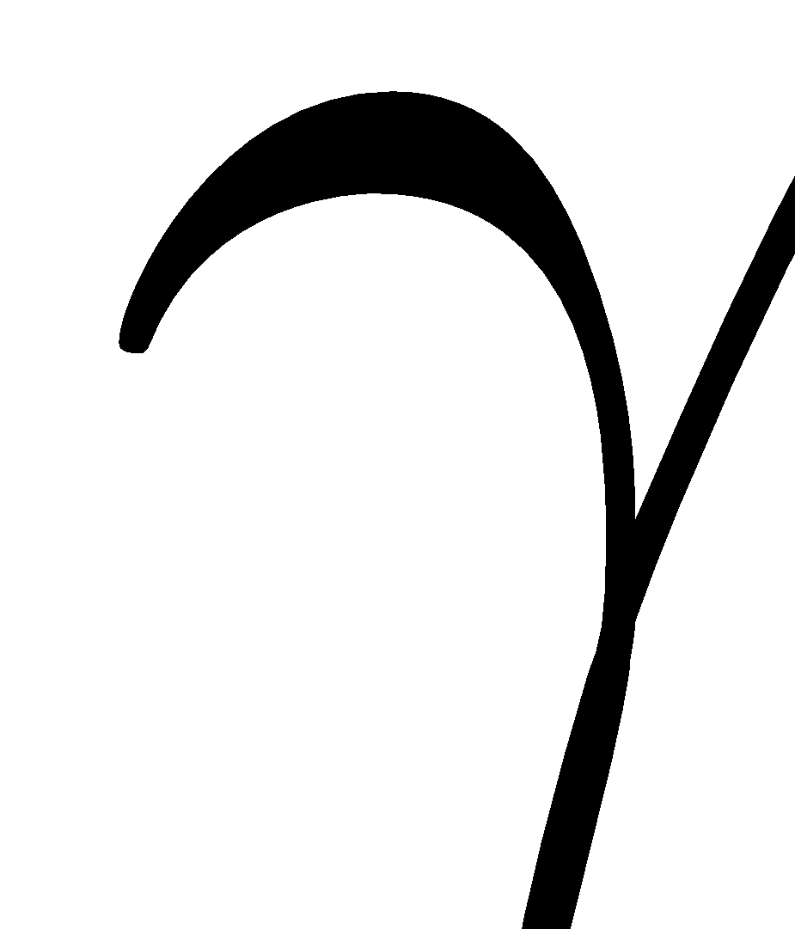
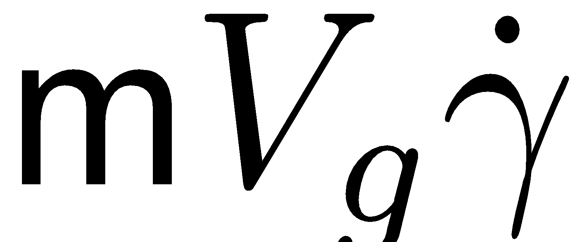
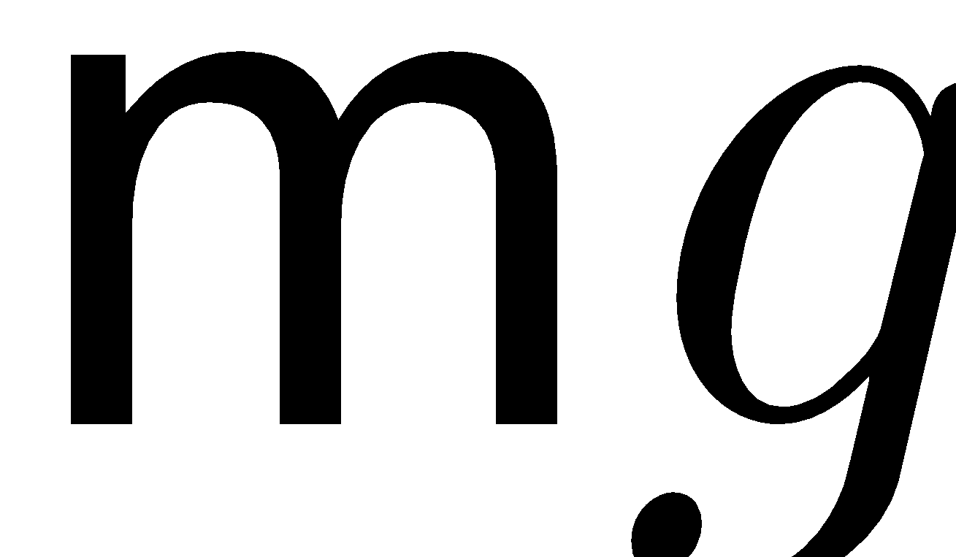
Accelerating Climb
Notes:
\begin{minipage}{4.5in}
\newcommand{\mass}{\mathsf{m}}
Summing forces gives
\[
F_{\text{lift}}\cos\phi = \mass V_g\dot\gamma + \mass g\cos\gamma
\]
Solving for $\dot\gamma$:
\[
\dot\gamma = \frac{g}{V_g}\left( \frac{F_{\text{lift}}}{\mass g}\cos\phi - \cos\gamma\right)
\]
The load factor (often expressed in $g$’s) is defined as
\[
n_{\mathit{lf}}\defeq F_{\text{lift}}/\mass g.
\]
Note that for wings level, horizontal flight $n_{\mathit{lf}}=1$. Therefore
\[
\dot\gamma = \frac{g}{V_g}\left( n_{\mathit{lf}}\cos\phi - \cos\gamma\right)
\]
In a constant climb where $\dot{\gamma} = 0$, we have $n_{\mathit{lf}} = \frac{\cos\gamma}{\cos\phi}$.
\end{minipage}

Slide 10
Kinematic Guidance Models
Several guidance models can be derived, with varying levels of fidelity
Choice of model depends on application

Slide 11
Kinematic Guidance Model - #1a
Notes:
\begin{minipage}{4.5in}
\noindent
The simplest model (and the one used in Chapters 10, 11, 12) is given by
\begin{align*}
\dot{p}_n &= V_a \cos{\color{red}\psi} + {\color{blue}w_n} \\
\dot{p}_e &= V_a \sin{\color{red}\psi} + {\color{blue}w_e} \\
\ddot{\chi} &= b_{\dot{\chi}}(\dot{\chi}^c-\dot{\chi}) + b_{\chi}({\color{blue}\chi^c}-\chi) \\
\ddot{h} &= b_{\dot{h}}(\dot{h}^c - \dot{h}) + b_h({\color{blue}h^c}-h) \\
\dot{V_a} &= b_{V_a} ({\color{blue}V_a^c} - V_a)
\end{align*}
where $\psi$ is given by (equation (2.12))
\[
{\color{red}\psi} = \chi - \sin^{-1}\left(\frac{1}{V_a}\begin{pmatrix}w_n \\ w_e\end{pmatrix}^{\top}\begin{pmatrix}-\sin\chi \\ \cos\chi\end{pmatrix}\right)
\]
\end{minipage}

Slide 12
Kinematic Guidance Model - #1b
Notes:
\begin{minipage}{4.0in}
\noindent
If the autopilot is designed to command heading instead of course, then the model becomes
\begin{align*}
\dot{p}_n &= V_a \cos\psi + {\color{blue}w_n} \\
\dot{p}_e &= V_a \sin\psi + {\color{blue}w_e} \\
\ddot{\psi} &= b_{\dot{\psi}}(\dot{\psi}^c-\dot{\psi}) + b_{\psi}({\color{blue}\psi^c}-\psi) \\
\ddot{h} &= b_{\dot{h}}(\dot{h}^c - \dot{h}) + b_h({\color{blue}h^c}-h) \\
\dot{V_a} &= b_{V_a} ({\color{blue}V_a^c} - V_a)
\end{align*}
\end{minipage}

Slide 13
Kinematic Guidance Models - #2a
Notes:
\begin{minipage}{5.0in}
\noindent
A more accurate model is to command the roll angle and use the coordinated turn model for $\chi$:
\begin{align*}
\dot{p}_n &= V_a \cos{\color{red}\psi} + {\color{blue}w_n} \\
\dot{p}_e &= V_a \sin{\color{red}\psi} + {\color{blue}w_e} \\
\dot\chi &= \frac{g}{{\color{red}V_g}}\tan\phi \cos(\chi-{\color{red}\psi})\\
\ddot{h} &= b_{\dot{h}}(\dot{h}^c - \dot{h}) + b_h({\color{blue}h^c}-h) \\
\dot{V_a} &= b_{V_a} ({\color{blue}V_a^c} - V_a) \\
\dot\phi &= b_{\phi} ({\color{blue}\phi^c}-\phi)
\end{align*}
where $\psi$ and $V_g$ are given by (equations (2.10) and (2.12))
\begin{align*}
{\color{red}\psi} &= \chi - \sin^{-1}\left(\frac{1}{V_a}\begin{pmatrix}w_n \\ w_e\end{pmatrix}^{\top}\begin{pmatrix}-\sin\chi \\ \cos\chi\end{pmatrix}\right) \\
{\color{red}V_g} &= w_n\cos\chi+w_e\sin\chi + \sqrt{(w_n\cos\chi+w_e\sin\chi)^2+V_a^2-w_n^2-w_e^2}
\end{align*}
\end{minipage}

Slide 14
Kinematic Guidance Models - #2b
Notes:
\begin{minipage}{5.0in}
\noindent
Or, in terms of heading we have
\begin{align*}
\dot{p}_n &= V_a \cos\psi + {\color{blue}w_n} \\
\dot{p}_e &= V_a \sin\psi + {\color{blue}w_e} \\
\dot\psi &= \frac{g}{V_a}\tan\phi\\
\ddot{h} &= b_{\dot{h}}(\dot{h}^c - \dot{h}) + b_h({\color{blue}h^c}-h) \\
\dot{V_a} &= b_{V_a} ({\color{blue}V_a^c} - V_a) \\
\dot\phi &= b_{\phi} ({\color{blue}\phi^c}-\phi)
\end{align*}
where $\chi$ and $V_g$ are computed from the wind triangle if needed by the autopilot
\end{minipage}

Slide 15
Kinematic Guidance Models - #3
Notes:
\begin{minipage}{4.5in}
\noindent
More accurate still is to command the flight path angle
\begin{align*}
\dot{p}_n &= V_a \cos\psi\cos{\color{red}\gamma_a} + {\color{blue}w_n} \\
\dot{p}_e &= V_a \sin\psi\cos{\color{red}\gamma_a} + {\color{blue}w_e} \\
\dot{h} &= V_a \sin{\color{red}\gamma_a} - {\color{blue}w_d} \\
\dot\psi &= \frac{g}{V_a}\tan\phi \\
\dot\gamma &= b_{\gamma}({\color{blue}\gamma^c}-\gamma) \\
\dot{V_a} &= b_{V_a} ({\color{blue}V_a^c} - V_a) \\
\dot\phi &= b_{\phi} ({\color{blue}\phi^c}-\phi)
\end{align*}
where $\gamma_a$ is given by equation (2.11)
\[
{\color{red}\gamma_a} = \sin^{-1}\left( \frac{V_g\sin\gamma+w_d}{V_a} \right)
\]
and $\chi$ and $V_g$ are computed from the wind triangle if needed by the autopilot
\end{minipage}

Slide 16
Kinematic Guidance Models - #4
Notes:
\begin{minipage}{3.5in}
More accurate still is to command the load factor
\begin{align*}
\dot{p}_n &= V_a \cos\psi\cos{\color{red}\gamma_a} + {\color{blue}w_n} \\
\dot{p}_e &= V_a \sin\psi\cos{\color{red}\gamma_a} + {\color{blue}w_e} \\
\dot{h} &= V_a \sin{\color{red}\gamma_a} -w_d \notag \\
\dot\psi &= \frac{g}{V_a}\tan\phi\\
\dot\gamma &= \frac{g}{V_g}\left( n_{\mathit{lf}}\cos\phi - \cos\gamma\right) \notag \\
\dot{V_a} &= b_{V_a} ({\color{blue}V_a^c} - V_a) \notag \\
\dot\phi &= b_{\phi} ({\color{blue}\phi^c}-\phi) \notag \\
\dot{n}_{\mathit{lf}} &= b_n ({\color{blue}n_{\mathit{lf}}^c}-n_{\mathit{lf}})
\end{align*}
where $\chi$, $V_g$, and $\gamma_a$ are computed from the wind triangle
\end{minipage}

Slide 17
Dubins Airplane Model
Notes:
\begin{minipage}{2.5in}
The Dubin's airplane model is a particularly simple model often used in path planning:
\begin{align*}
\dot{r}_n &= V\cos\psi \cos{\color{blue}\gamma^c} \\
\dot{r}_e &= V\sin\psi \cos{\color{blue}\gamma^c} \\
\dot{r}_d &= -V\sin{\color{blue}\gamma^c} \\
\dot{\psi} &= \frac{g}{V}\tan{\color{blue}\phi^c}.
\end{align*}
Assumes constant velocity $V$, and subject the constraints:
\begin{align*}
\abs{{\color{blue}\phi^c}} &\leq \bar{\phi} \\
\abs{{\color{blue}\gamma^c}} &\leq \bar{\gamma}.
\end{align*}
\end{minipage}

Slide 18
Dubins Airplane Model (simplified)
Notes:
\begin{minipage}{2.5in}
Often simplified as:
\begin{align*}
\dot{r}_n &= V\cos\psi \\
\dot{r}_e &= V\sin\psi \\
\dot{r}_d &= -V\sin{\color{blue}\gamma^c} \\
\dot{\psi} &= \frac{g}{V}\tan{\color{blue}\phi^c}.
\end{align*}
Assumes constant velocity $V$, and subject the constraints:
\begin{align*}
\abs{{\color{blue}\phi^c}} &\leq \bar{\phi} \\
\abs{{\color{blue}\gamma^c}} &\leq \bar{\gamma}.
\end{align*}
\end{minipage}

Slide 19
Dynamic Guidance Models
Notes:
\begin{minipage}{2.0in}
Standard kinematic expression for evolution of position:
\begin{align*}
\dot{p}_n &= V_g \cos\chi\cos\gamma \\
\dot{p}_e &= V_g \sin\chi\cos\gamma \\
\dot{p}_d &= -V_g \sin\gamma.
\end{align*}
\end{minipage}

Slide 20
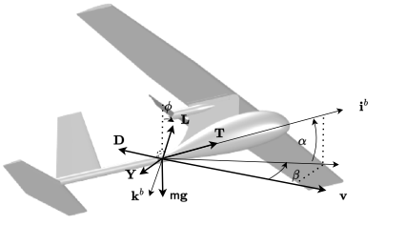
Dynamic Guidance Models
Notes:
\begin{minipage}{2.5in}
Thrust in the wind frame:
\begin{align*}
\mathbf{T}^w &= R_b^w \mathbf{T}^b \\
&= \begin{pmatrix}
\cos\alpha\cos\beta & \sin\beta & \sin\alpha\cos\beta \\
-\cos\alpha\sin\beta & \cos\beta & -\sin\alpha\sin\beta \\
-\sin\alpha & 0 & \cos\alpha
\end{pmatrix} \begin{pmatrix}T \\ 0 \\ 0 \end{pmatrix}\\
&= \begin{pmatrix} T \cos\alpha\cos\beta \\ -T \cos\alpha\sin\beta \\ -T\sin\alpha\end{pmatrix}.
\end{align*}
\vspace{0.5cm}
Aerodynamic forces in the wind frame:
\[
\mathbf{F}_{aero}^w = \begin{pmatrix} -D \\ -Y \\ -L \end{pmatrix}
\]
\end{minipage}

Slide 21
Dynamic Guidance Models
Notes:
\begin{minipage}{3.0in}
Total forces in the wind frame:
\[
\mathbf{F}^w = \begin{pmatrix} -D + T \cos\alpha\cos\beta \\ -Y-T \cos\alpha\sin\beta \\ -L-T\sin\alpha \end{pmatrix}.
\]
Total forces in the vehicle-2 (unrolled) frame:
\begin{align*}
\mathbf{F}^{v2} &= \begin{pmatrix} 1 & 0 & 0 \\ 0 & \cos\phi & -\sin\phi \\ 0 & -\sin\phi & \cos\phi \end{pmatrix}\begin{pmatrix} -D + T \cos\alpha\cos\beta \\ -Y-T \cos\alpha\sin\beta \\ -L-T\sin\alpha \end{pmatrix}\\
&= \begin{pmatrix}
-D + T \cos\alpha\cos\beta \\
-(Y+T \cos\alpha\sin\beta)\cos\phi - (L+T\sin\alpha)\sin\phi \\
(Y+T \cos\alpha\sin\beta)\sin\phi - (L+T\sin\alpha)\cos\phi
\end{pmatrix}.
\end{align*}
\end{minipage}

Slide 22
Dynamic Guidance Models
Notes:
\begin{minipage}{3.0in}
\newcommand{\mass}{\mathsf{m}}
Along the $\mathbf{i}^{v2}$ axis, the magnitude of the velocity vector evolves as:
\begin{align*}
\mass\dot{V}_g &= T \cos\alpha\cos\beta - D - \mass g\sin\gamma \\
\implies \dot{V}_g &= \frac{T}{\mass} \cos\alpha\cos\beta - \frac{D}{\mass} - g\sin\gamma.
\end{align*}
\end{minipage}

Slide 23
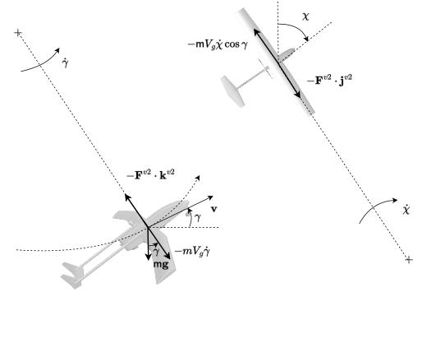
Dynamic Guidance Models
Notes:
\begin{minipage}{3.0in}
\newcommand{\mass}{\mathsf{m}}
Given:
\begin{align*}
\mathbf{F}^{v2}
&= \begin{pmatrix}
-D + T \cos\alpha\cos\beta \\
-(Y+T \cos\alpha\sin\beta)\cos\phi - (L+T\sin\alpha)\sin\phi \\
(Y+T \cos\alpha\sin\beta)\sin\phi - (L+T\sin\alpha)\cos\phi
\end{pmatrix}.
\end{align*}
\vspace{1cm}
Longitudinal direction:
\begin{align*}
\mass V_g\dot{\gamma} &= - (Y+T \cos\alpha\sin\beta)\sin\phi + (L+T\sin\alpha)\cos\phi - \mass g\cos\gamma \\
\implies
\dot{\gamma} &= \frac{1}{\mass V}\left[(L+T\sin\alpha)\cos\phi - (Y+T \cos\alpha\sin\beta)\sin\phi - \mass g\cos\gamma \right].
\end{align*}
\vspace{1cm}
Lateral direction:
\begin{align*}
\mass V_g\dot{\chi}\cos\gamma &= (Y+T \cos\alpha\sin\beta)\cos\phi + (L+T\sin\alpha)\sin\phi \\
\implies
\dot{\chi} &= \frac{1}{\mass V_g\cos\gamma}\left[(Y+T \cos\alpha\sin\beta)\cos\phi + (L+T\sin\alpha)\sin\phi\right].
\end{align*}
\end{minipage}

Slide 24
Dynamic Guidance Models: Summary
Notes:
\begin{minipage}{3.0in}
\newcommand{\mass}{\mathsf{m}}
\begin{align*}
\dot{p}_n &= V_g \cos\chi\cos\gamma \\
\dot{p}_e &= V_g \sin\chi\cos\gamma \\
\dot{h} &= V_g \sin\gamma \\
\dot{V}_g &= \frac{{\color{blue}T}}{\mass} \cos{\color{blue}\alpha}\cos{\color{blue}\beta} - \frac{D}{\mass} - g\sin\gamma \\
\dot{\chi} &= \frac{1}{\mass V_g\cos\gamma}\left[(Y+{\color{blue}T} \cos{\color{blue}\alpha}\sin{\color{blue}\beta})\cos{\color{blue}\phi} + (L+{\color{blue}T}\sin{\color{blue}\alpha})\sin{\color{blue}\phi}\right] \\
\dot{\gamma} &= \frac{1}{\mass V_g}\left[(L+{\color{blue}T}\sin{\color{blue}\alpha})\cos{\color{blue}\phi} - (Y+{\color{blue}T} \cos{\color{blue}\alpha}\sin{\color{blue}\beta})\sin{\color{blue}\phi} - \mass g\cos\gamma \right],
\end{align*}
where
\begin{align*}
L(\alpha) &= \frac{1}{2}\rho V_a^2 S \left(C_{L_0} + C_{L_\alpha}{\color{blue}\alpha}\right) \\
D(\alpha) &= \frac{1}{2}\rho V_a^2 S \left(C_{D_0} + C_{D_\alpha}{\color{blue}\alpha} + C_{D_{\alpha^2}}{\color{blue}\alpha}^2\right) \\
Y(\beta) &= \frac{1}{2}\rho V_a^2 S C_{Y_\beta} {\color{blue}\beta},
\end{align*}
\end{minipage}

Slide 25
Dynamic Guidance Models: Summary (simplified)
Notes:
\begin{minipage}{3.0in}
\newcommand{\mass}{\mathsf{m}}
When sideslip is regulated to zeros:
\begin{align*}
\dot{p}_n &= V_g \cos\chi\cos\gamma \\
\dot{p}_e &= V_g \sin\chi\cos\gamma \\
\dot{h} &= V_g \sin\gamma \\
\dot{V}_g &= \frac{{\color{blue}T}}{\mass} \cos{\color{blue}\alpha} - \frac{D}{\mass} - g\sin\gamma \\
\dot{\chi} &= \frac{1}{\mass V_g\cos\gamma}\left(L+{\color{blue}T}\sin{\color{blue}\alpha}\right)\sin{\color{blue}\phi} \\
\dot{\gamma} &= \frac{1}{\mass V_g}\left[(L+{\color{blue}T}\sin{\color{blue}\alpha})\cos{\color{blue}\phi} - \mass g\cos\gamma \right],
\end{align*}
where
\begin{align*}
L(\alpha) &= \frac{1}{2}\rho V_a^2 S \left(C_{L_0} + C_{L_\alpha}{\color{blue}\alpha}\right) \\
D(\alpha) &= \frac{1}{2}\rho V_a^2 S \left(C_{D_0} + C_{D_\alpha}{\color{blue}\alpha} + C_{D_{\alpha^2}}{\color{blue}\alpha}^2\right)
\end{align*}
\end{minipage}

